Slide 1

Diagnosing Contextual Content Moderation Gaps in the India–Bengali Market
Notes:
To change the image on this slide, select the picture and delete it. Then click the Pictures icon in the placeholder to insert your own image.

Slide 2
Contextual offensive content in the India–Bengali market is systematically under-detected, leading to delayed enforcement and silent harm
AI moderation avoids over-flagging benign content but misses a significant share of offensive posts
Missed content remains live ~2× longer, increasing user harm
Risk concentrates in comments, crisis periods, and contextual content
Market-specific operational interventions are required to close the gap

Slide 3
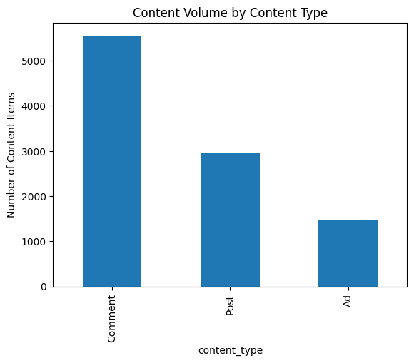
High-volume, user-generated content dominates the moderation workload
Comments ≈ 50% of total content volume
Posts (~30%) and Ads (~15%) form smaller shares
User interactions, not ads, drive moderation exposure

Slide 4
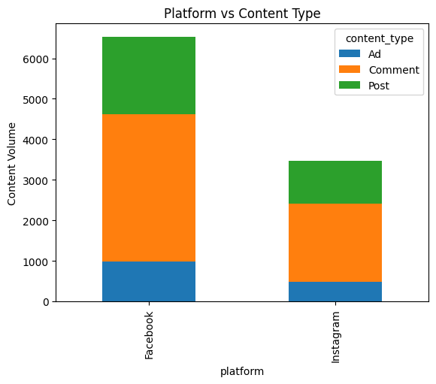
Facebook carries higher and more diverse moderation risk than Instagram
Facebook dominates overall volume and content diversity
Instagram is comment-heavy, amplifying conversational risk
Platform mix affects how enforcement capacity must be allocated

Slide 5
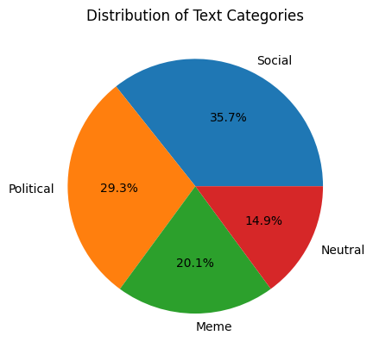
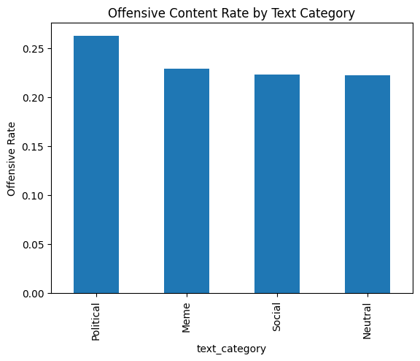
Most content is socially or politically expressive, limiting keyword-based detection
Nearly 50% of content is politically or meme-tically expressive
These categories rely heavily on context, tone, and implication, not explicit abuse
Offensiveness is not confined to “expected” categories — even neutral-looking content carries risk.

Slide 6
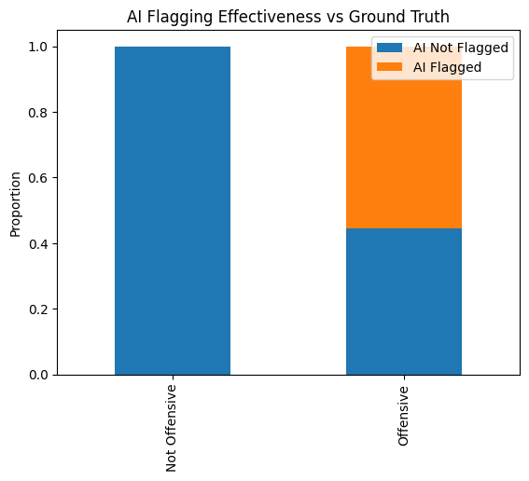
AI moderation avoids false positives but fails to catch a large share of offensive content.
For non-offensive content, AI correctly leaves ~90% unflagged
For offensive content, AI misses ~40–45%
Indicates high precision, low recall
The system is conservative by design — but this creates silent exposure risk.

Slide 7
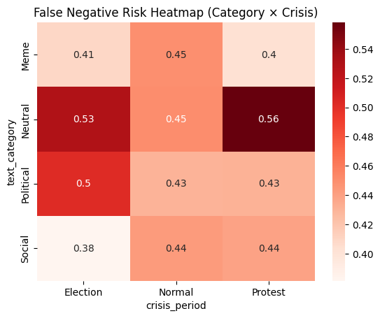
Detection failures intensify at specific category × crisis intersections.
Highest false-negative risks:
Neutral × Protest (~0.56)
Meme × Protest (~0.56)
Neutral × Election (~0.53)
Lowest risk:
Social × Election (~0.38)
Seemingly benign or humorous content becomes dangerous in volatile contexts
AI struggles most when context flips meaning

Slide 8
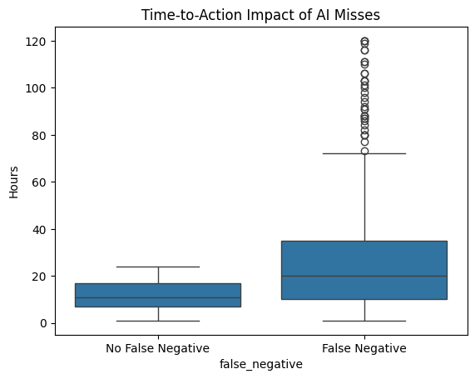
AI misses significantly increase time-to-action, extending user harm.
No false negatives:
Median TTA ≈ 20 hours
Tight distribution, low variance
False negatives:
Median TTA ≈ 40 hours
Long tail up to 120 hours
Missed content stays live 2× longer, compounding harm during sensitive periods.

Slide 9
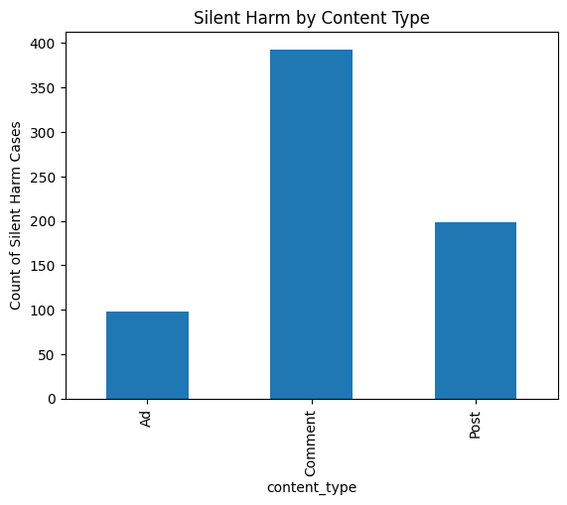
High-volume comment streams are the largest source of undetected harm.
Silent harm cases:
Comments: ~350
Posts: ~200
Ads: ~100
Scale + conversational dynamics make comments hardest to police
Reliance on user reporting is insufficient

Slide 10
Resolution: Market-specific, context-aware operations can materially reduce risk without over-enforcement.
Contextual Risk Routing
Prioritize human review for:
  Comments
  Meme & Neutral content
  Protest & Election periods
Crisis Playbooks
Expect higher false negatives during crises
Pre-emptively allocate review capacity
Expected Outcomes
Faster time-to-action
Reduced silent harm
Lower escalation risk
False-Negative Monitoring
  Track category × crisis risk patterns as operational KPIs
  Use these signals to guide escalations

